Slide 1




Business Insights 360
Presented By: Kanchan Sinha

Slide 2

content
Company Overview
Business Model
Problem Statement
Objective
Dashboard Overview
Key Insights and recommendations

Slide 3
Company overview
AtliQ Hardware is a leading consumer electronics brand specializing in selling a wide range of hardware products, including personal computers (PCs), computer peripherals, storage devices, printers, and more across the Globe.
It provide high-quality and innovative technology solutions to meet diverse needs of consumer.

Slide 4
Platform presence
Brick & Mortar
E-Commerce
Physical store where consumers can browse and purchase products in person.
E.g. – Croma, Best Buy, AtliQ e store & exclusive etc.
Consumers can browse and purchase products digitally.
E.g. – Flipkart, Amazon etc.

Slide 5




Distribution channel
Retailer
Direct
Distributor
Neptune
e Store
exclusive

Slide 6

Problem statement
AtliQ Hardware, a fast-growing company, established its own store in Latin America, but they faced a huge loss due to decisions based on just surveys and intuition.
01
They still rely on Excel for data analytics, but Excel files can be cumbersome and ineffective for generating insights.
02

Slide 7
Objective
Generate a comprehensive report using advanced capabilities of Power BI to gain deep insights into operational performance.
Identify opportunities for profit and loss reduction.
Implement strategies to reduce losses and increase profitability by 10%.
Continuously monitor performance metrics to ensure sustained improvements and adapt strategies as needed.

Slide 8
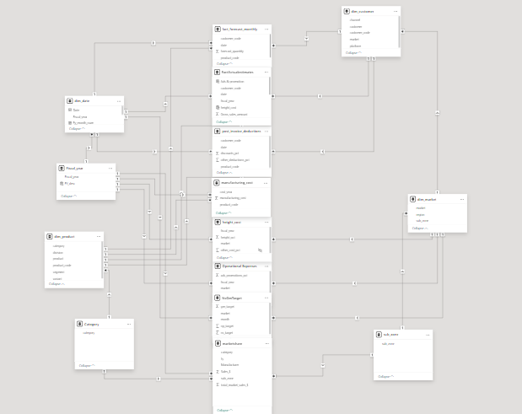
Data model
Snowflake Data Model
The Snowflake data model is a normalized schema used in data warehousing where dimension tables are organized into related sub-tables, forming a structure like a snowflake.

Slide 9
Data description
SQL Database
Excel files
GDB041
GDB056
Market Share
Operational expenses
Target 2020
Dim Customer
Manufacturing Cost
AtliQ & its Competitor's data
AtliQ ‘s Advertisement & promotional expense data
Target Data for 2020 provided by product owner
Dim Product
Pre-Invoice Deduction
Dim Market
Post-Invoice Deduction
Fact Sales Monthly
Freight Cost
Fact Forecast Monthly
Gross Price

Slide 10
Dashboard overview
Finance View
Marketing View
Executive View
Sales View
Supply chain View

Slide 11
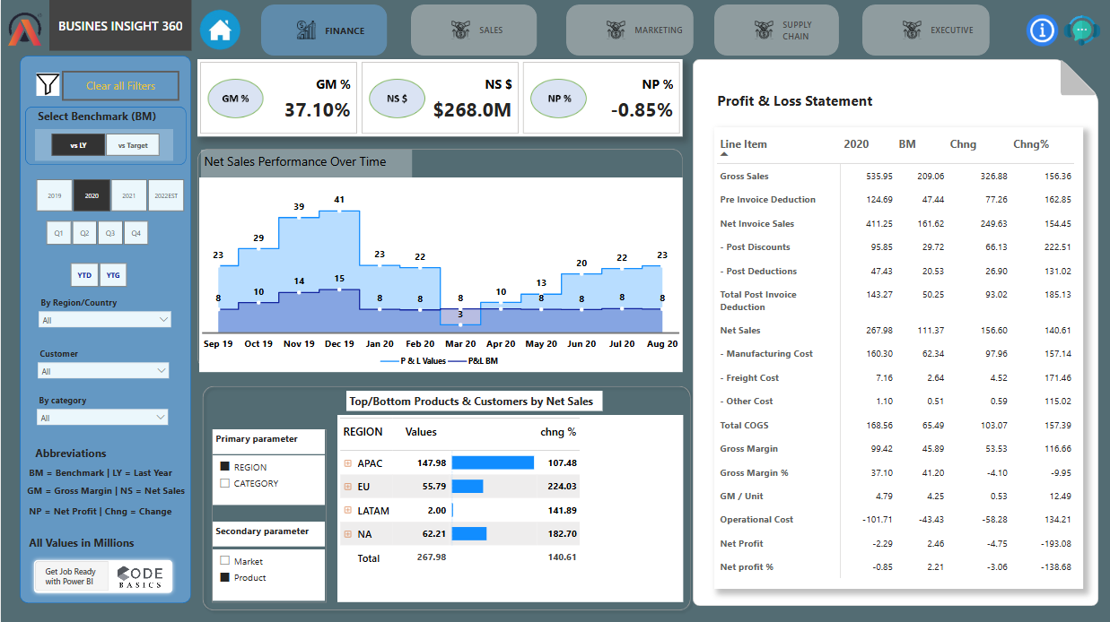
Finance view

Slide 12
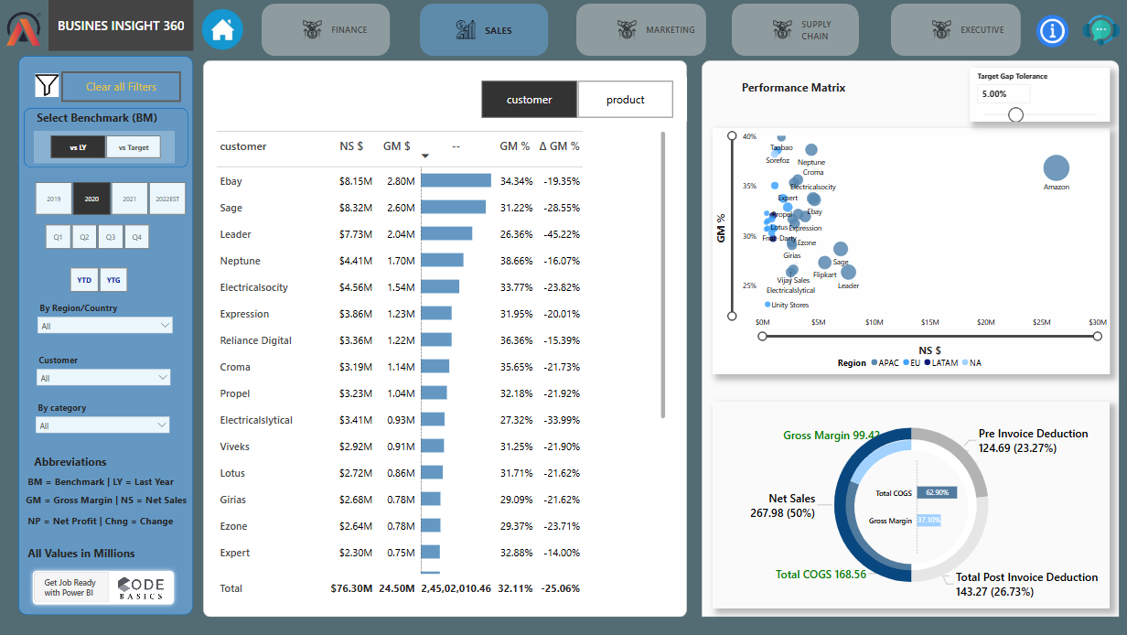
sales view

Slide 13
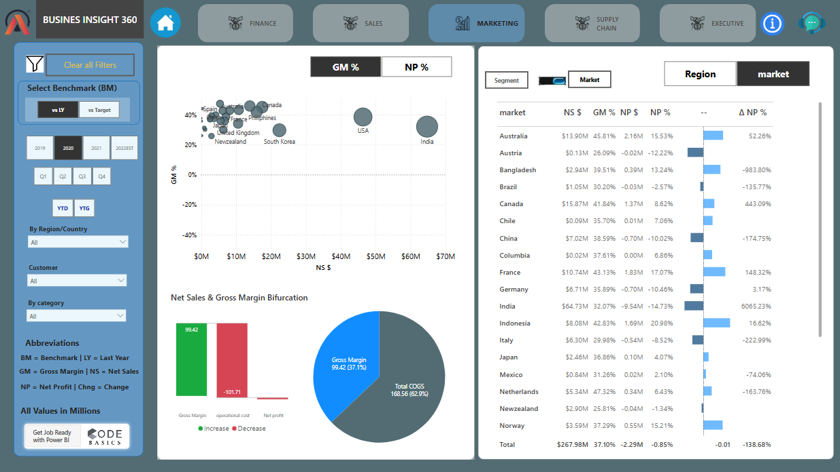
marketing view

Slide 14
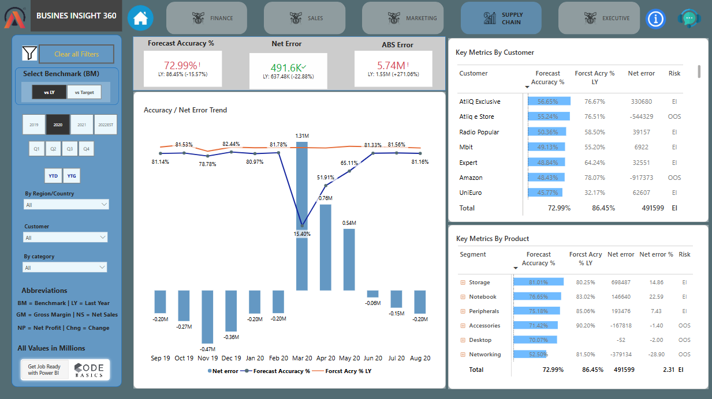
Supply chain view

Slide 15
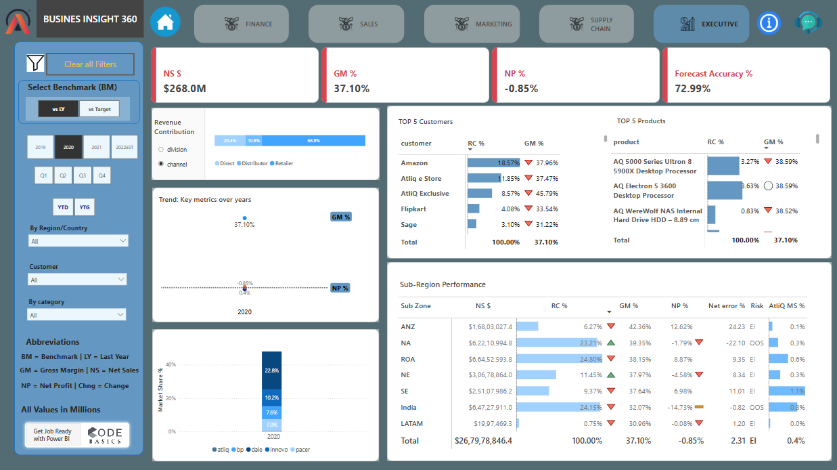
Executive view

Slide 16
Key insights
For the fiscal year 2022
The gross margin increased by 1.5%, and net profit saw a modest improvement in 2022 (up to December) compared to 2021.
The APAC region led all other regions in net sales , while the USA ranked highest in net sales on a country level.
Amazon, AtliQ Exclusive, and AtliQ E-Store were the top three contributors to net sales for AtliQ Hardware.
The forecast accuracy is 81%. Additionally, this accuracy is higher than it was last year, reflecting improvements in data quality and forecasting methods.
In 2021, AtliQ Hardware's market share was 1%, which increased to 5% in 2022. The company also ranked 5th among manufacturers of PCs and their peripherals.

Slide 17
Recommendation
The company should renegotiate with customers and focus on offering high-quality products instead of relying on substantial discounts.
The company should lower operating costs to achieve a positive net profit.
In the networking segment, the "Wi-Fi Extender" product is incurring losses. Company should Contact the product manager to identify and address the underlying issues.
To address losses in Brazil, connect with the regional head to discuss competitive strategies and focus on strengthening marketing efforts to improve brand positioning and customer engagement.

Slide 18


